Slide 1
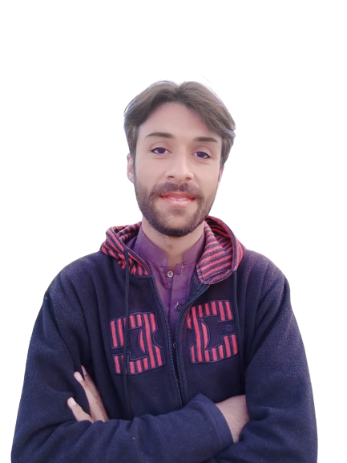
Complex Task Series
Problem Number 100

Slide 2
Problem Statement
Write a Desktop Application in Python To Get A Username From The User That Should Have Alphanumeric Characters

Slide 3
Algorithm
Step1: Create A Basic Window
Step2: Set Geometry For That Window
Step3: Get A Username From User
Step4: Check Username, Whether It Contain Alphanumeric Or Not.
Step5: Display Result To User
END

Slide 4
Assignment
Write a Desktop Application in Python To Get A Password From The User That Should Have Alphanumeric and Special Characters

